Slide 1

Lenskart Sales Overview

Slide 2
Introduction of Lenskart
☑ Lenskart is a tech driven eyewear brand transforming vision care through seamless online to offline experience and innovation.
☑ Lenskart operates a wide network of stores across multiple locations, both nationally and internationally.
☑ The main objective of lenskart is to make eye care and eyewear affordable, accessible and convenient for everyone.
☑ It aims to improve people’s vision through quality products, regular eye check-ups, and technology driven services.

Slide 3
Simplified Lenskart Flow
Customer Entry
↓
Eye testing(prescription check & upload)
↓
Frame & Lens selection
↓
Pricing & Offers
↓
Order Placing
↓
Manufacturing
↓
Delivery
↓
After Sales
↓
Repeat Purchase

Slide 4
Structure Of Sales Data
☑ The Excel file contains Lenskart sales data, transformed into a structured format for business analysis and reporting.
☑ It contains 36 rows of Lenskart ’ s different stores data in different locations.
☑ It primarily includes :
☑ Store & Location details
☑ Monthly Time data from jan-apr in 2025
☑ Store operations
☑ Product Information
☑ Revenue & Cost metrics
☑ Performance ratio’s & KPI’s

Slide 5
Objective Of The Analysis
☑ The dashboard focuses on analysis of sales trends, brand performance, category contribution, and conversion efficiency.
INSIGHTS THROUGH DASHBOARD:
☑ To understand business growth and sales pattern overtime.
☑ Helps to identify performing & underperforming products.
☑ It shows the strong revenue concentration in different locations.
☑ Improving conversion by even 1 to 2% can generate significant incremental revenue.
☑ Supports strategic decisions related to brand.
☑ Measures sales efficiency & store performance.

Slide 6
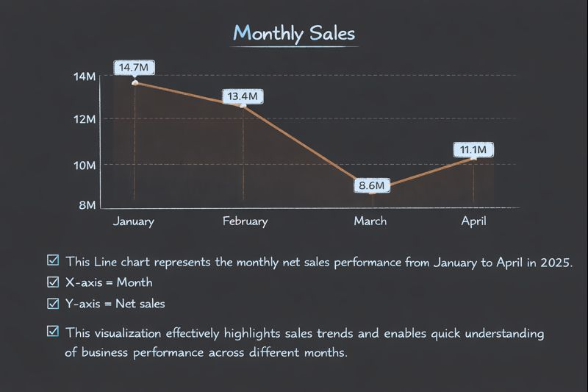
Monthly Sales Performance
☑ This Line chart represents the monthly net sales performance from January to April in 2025.
☑ Metrics used : Month & Net sales
☑ This visualization effectively highlights sales trends and enables quick understanding of business performance across different months.

Slide 7
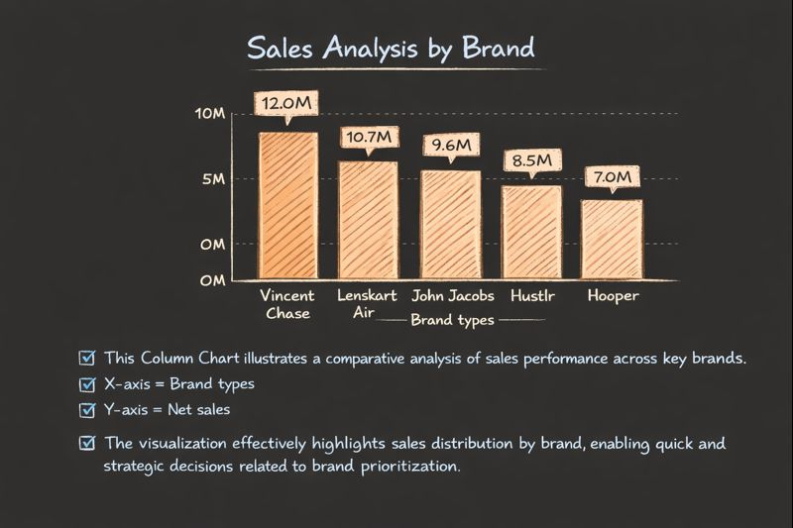
Sales Analysis by Brand
☑ This Column Chart illustrates a comparative analysis of sales performance across key brands.
☑ Metrics used : Brand types & Net sales
☑ The visualization effectively highlights sales distribution by brand, enabling quick and strategic decisions related to brand prioritization.

Slide 8
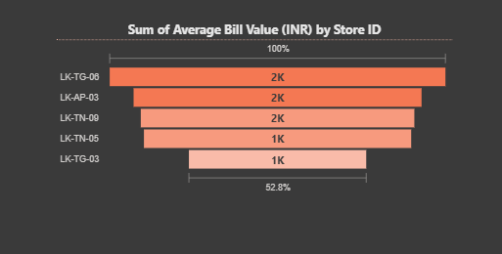
Top Performance Stores
☑ The chart highlights store-wise contribution to average bill value, filtered by profit, showing clear performance gaps between top and low-performing stores.
☑ Metrics used : Sum of average bill value , Store id and filtered by Profit.
☑ This slide shows the sum of average bill value by store, filtered to include only profitable stores.

Slide 9
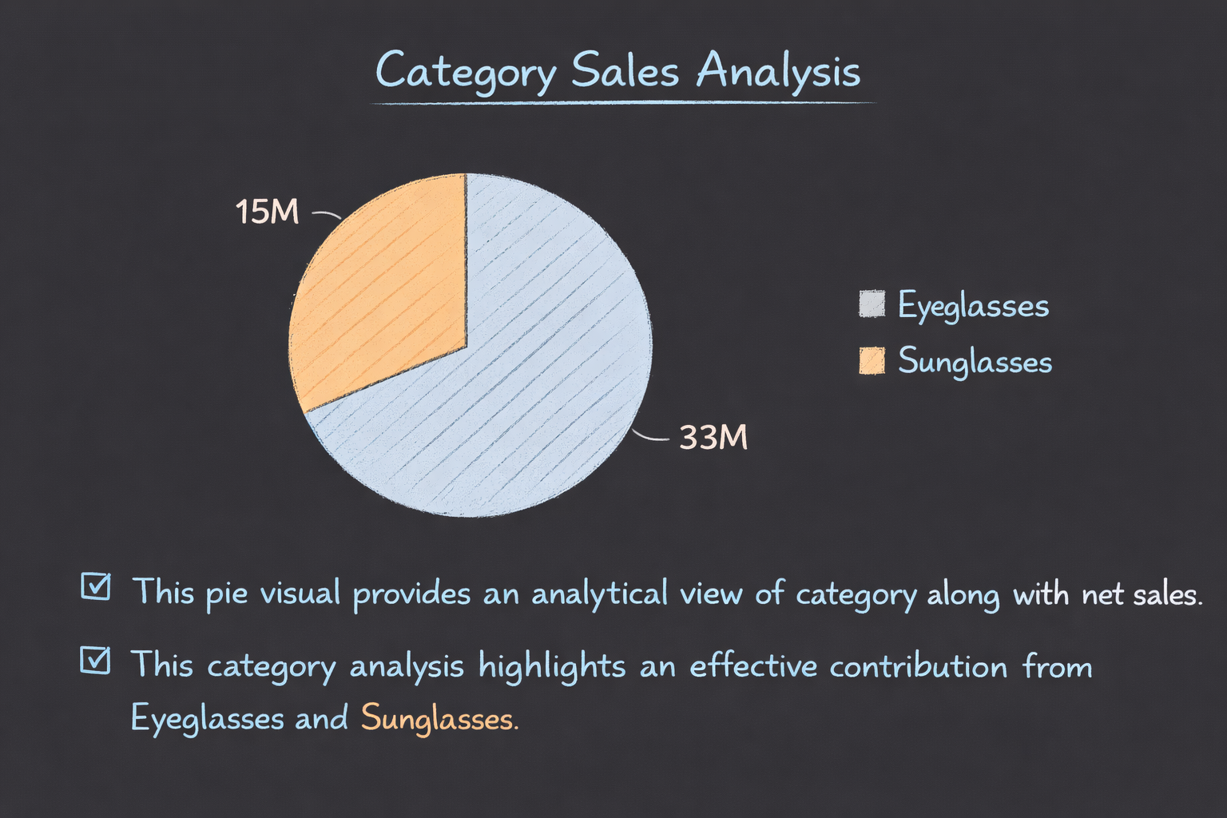
Category & Net Sales Analysis
☑ The pie visual provides an analytical view of category along with net sales.
☑ This category analysis highlights an effective contribution from Eyeglasses and Sunglasses.

Slide 10
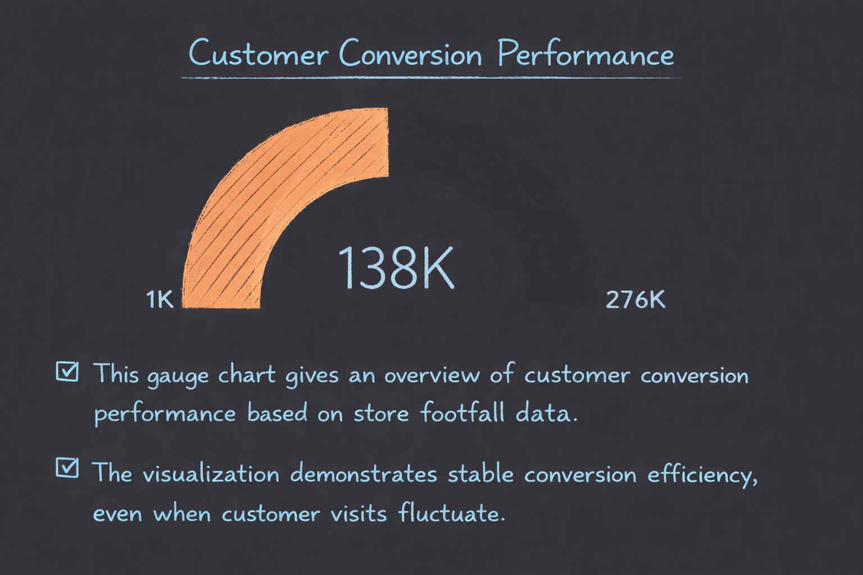
Overall Conversion Rate
☑ The gauge chart gives an overview of customer conversion performance based on store footfall data.
☑ The Visualization demonstrates stable conversion efficiency, even when customer visits fluctuate

Slide 11
Map
☑ The map visual represents lenskart’s store locations across different states and cities in the southern part of India.
☑ This visual helps us to understand where lenskart stores are located geographically and how sales are distributed across different regions.
☑ This regional spread supports both revenue stability and future expansion opportunities.
☑ The stores are spread across the following states:
☑ Andhra Pradesh
☑ Telangana
☑ Karnataka
☑ Tamilnadu

Slide 12
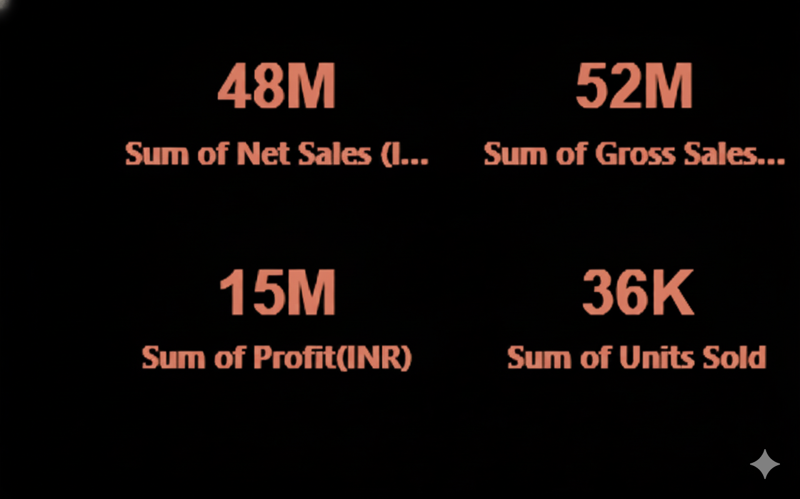
Cards
☑ This card provides a high level summary of lenskart’s overall sales and performance across all stores and locations.
☑ It Gives an instant understanding of business performance
☑ This card visual use to track key performance indicators
(KPI’s)such as :
☑ Sum of Net sales
☑ Sum of Gross sales
☑ Sum of Profit
☑ Sum of Units sold

Slide 13
Analysis & Conclusion
☑ The dashboard provides a consolidated view of sales and customer performance across brands, categories according to the time periods.
☑ The data reveals consistent performance of key regions and key performance indicators with minimum fluctuations.
☑ Overall, the visuals support strategic decisions by highlighting high performing areas and trends.

Slide 14

THANK
20/100
20/70
20/50
20/40
20/30
20/20
YOU
FOR
YOUR
ATTENTION

